Slide 1

Federated Learning: AI Without Sharing Data
Privacy-Preserving AI for a Decentralized World
Saanch 221030441W
Nayana Singh 221030433W
Srishti 221030061W

Slide 2
Heard About Federated Learning?
What if?
Why Popular?
Your phone trains AI—data never leaves device
Explosion of smart devices, valuable local data
Rising privacy concerns, strict data regulations
Only model updates shared, not raw data

Slide 3

Centralized AI: The Hidden Privacy Problem
Centralized Training
Risks
Real-World Concerns
All user data sent to cloud
Data breaches, misuse, unauthorized access
Social media, finance, health—privacy violations

Slide 4
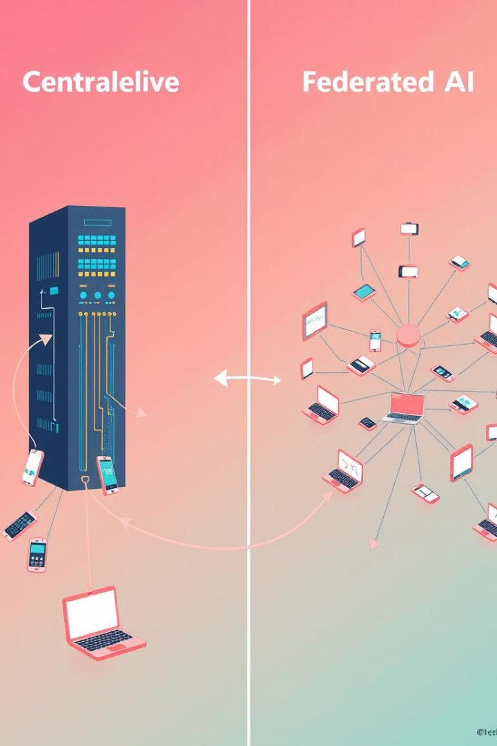



Federated Learning: A Paradigm Shift in AI
Decentralization
Training happens where data is generated
Privacy
Personal data stays local, not shared
Collaboration
Devices contribute to shared global model

Slide 5
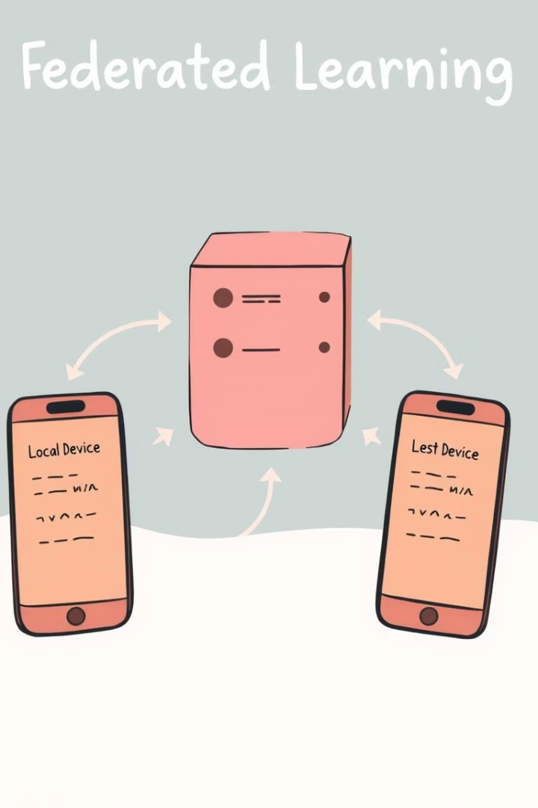




Inside the Federated Learning Pipeline
Local Training
Each device trains on its own data
Update Sharing
Only model updates sent to server
Aggregation
Server combines updates, improves global model
Repeat
Cycle continues for better accuracy
In the FedAvg algorithm, the server computes a weighted average of all client updates
based on the amount of data each device has. Then, this updated model is sent back to the
clients for another round of training — and the cycle continues.

Slide 6
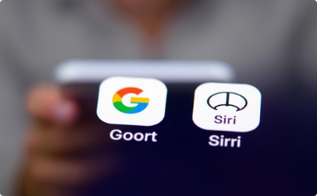



Real-World Applications of FL
Smart Devices
Finance
Automotive
Healthcare
Personalized AI, data stays on device
Fraud detection, privacy-preserving collaboration
Safer navigation, local learning in vehicles
Collaborative disease prediction, patient privacy

Slide 7
Federated Learning Tools :-
TensorFlow Federated , Pysyft , Flower AI.
Each client (hospital) trains a model locally on its private data . After local training , client sends only updated model weights to a central server .
The server aggregates these weights (usually by averaging them) to update the global model.
No raw data leaves the client - enhancing privacy by design.
But to enhance privacy these tools can be accompanied with differential privacy , smpc
(secure multi party computation ) basically an encryption technique , etc .

Slide 8
TensorFlow Federated :-
What is TFF?
An open-source framework by Google for simulating and prototyping federated
learning algorithms.
Built on top of TensorFlow and enables training on decentralized data.
Use Case Focus :-
Mainly research and experimentation.
Supports integration with TensorFlow Privacy for privacy-preserving training.

Slide 9
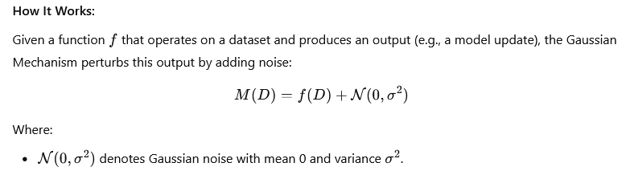
Enhancing Privacy with Differential Privacy (DP)
Why Differential Privacy in FL?
Federated Learning keeps data on-device, but model updates can still leak private
information.
DP adds mathematically guaranteed privacy to local computations before aggregation.

Slide 10
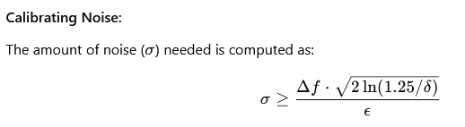
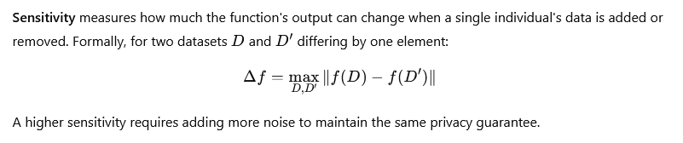

Slide 11
This ensures that the added noise provides the desired (ϵ,δ) - DP guarantee. It's crucial to calibrate sigma appropriately: too little noise may compromise privacy, while too much noise can degrade the utility of the model.
DP-FedAvg in TFF
DP-FedAvg = Federated Averaging + Differential Privacy
How DP is added to FedAvg :-
Each client clips their model updates to limit sensitivity.
Gaussian noise is added before sending updates to the server.
The server performs standard FedAvg over noisy updates.

Slide 12
Pysyft :-
What is PySyft?
PySyft is an open-source library that enables privacy-preserving, decentralized machine learning.
It extends PyTorch to support Federated Learning (FL), Differential Privacy (DP), and Encrypted Computations.
Allows data to stay at the source (e.g., hospitals, mobile devices) while still enabling model training across multiple data silos.
Key idea: Perform computations on data you never actually see.

Slide 13
Encrypted Computations with SMPC (Secure Multi-Party Computation)
SMPC allows multiple parties to compute on data without revealing private inputs.
Hospital A: model update = 3.5 , Hospital B: model update = 2.5
Each hospital splits its update into 3 random shares (using additive secret sharing):
A → [1.2, 0.7, 1.6] , B → [1.1, 0.9, 0.5]
Shares are sent to 3 servers:
Server 1: 1.2 + 1.1 = 2.3
Server 2: 0.7 + 0.9 = 1.6
Server 3: 1.6 + 0.5 = 2.1
Final Sum = 2.3 + 1.6 + 2.1 = 6.0, without ever revealing 3.5 or 2.5!

Slide 14
Flower AI :-
Why Flower AI?
Traditional FL frameworks are limited:
Some only support simulations, not real-world deployments
Others can't scale to millions of clients
There's a gap between research tools and production-level FL systems
Flower AI bridges this gap with a single framework for both simulation and deployment
Key Advantages of Flower AI :-
Flexible:
Works with any ML framework like PyTorch, TensorFlow, or custom code.

Slide 15
Scalable:
Can simulate millions of clients, even on modest hardware.
Realistic:
Supports deployment on real devices (phones, hospitals, IoT).
Enables real-world testing with production-ready setups.
Modular Design:
Swap in your own models, training loops, aggregation logic
Customize client selection, fault tolerance, etc.

Slide 16
Supports:
Cross-Device FL :
Thousands of unreliable clients with small data (e.g., smartphones).
Key challenges: limited bandwidth, dropout, device variability.
Cross-Silo FL :
Few stable clients with large datasets (e.g., hospitals).
Focus on compliance, governance, and data security.
Fault Tolerant :
Flower is fault tolerant means that FL systems can keep working constantly even if some clients drop in/out while training .

Slide 17
Simple and Powerful Client–Server Architecture :-
Minimal API required from clients :-
get_parameters(): Send model weights to server
fit(): Train model on local/private data
evaluate(): Return local evaluation metrics
Server responsibilities :-
Select clients per round , sending initial / global model , Aggregating model updates
and to decide when to stop training .

Slide 18
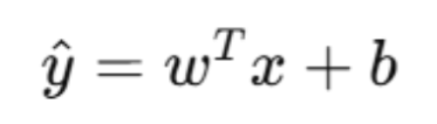
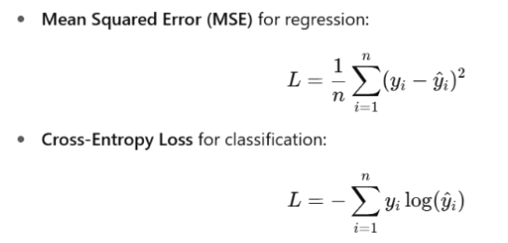
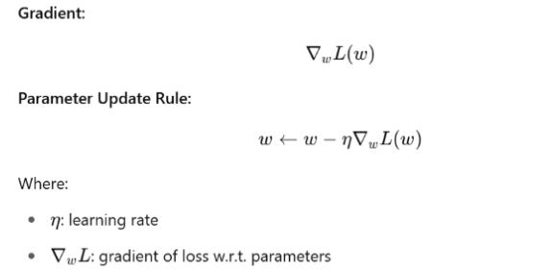
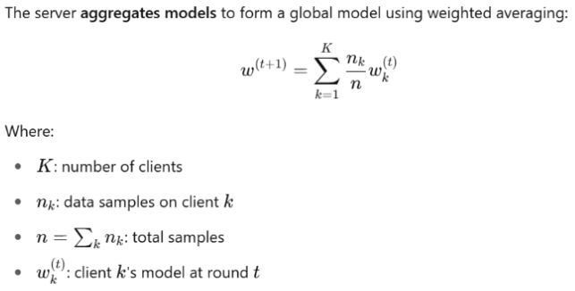
FL Under the Hood: A Mathematical Glimpse
:
Local Learning
i. Model (Linear):
ii. Loss Function:
iii. Optimisation: Gradient Descent
2. Central Server – Aggregation
3. Back to the Devices
– Model Update
Each device replaces its local model with this new version

Slide 19
A Project Pipeline
Step 0 – Initialize the Global Model
Step 1 – Broadcast to Selected Clients
Step 2 – Local Training on Private Data
Step 3 – Ship Back Updates, Not Data
Step 4 – Aggregate into a New Global Model
Step 5 – Rinse, Repeat, Converge

Slide 20
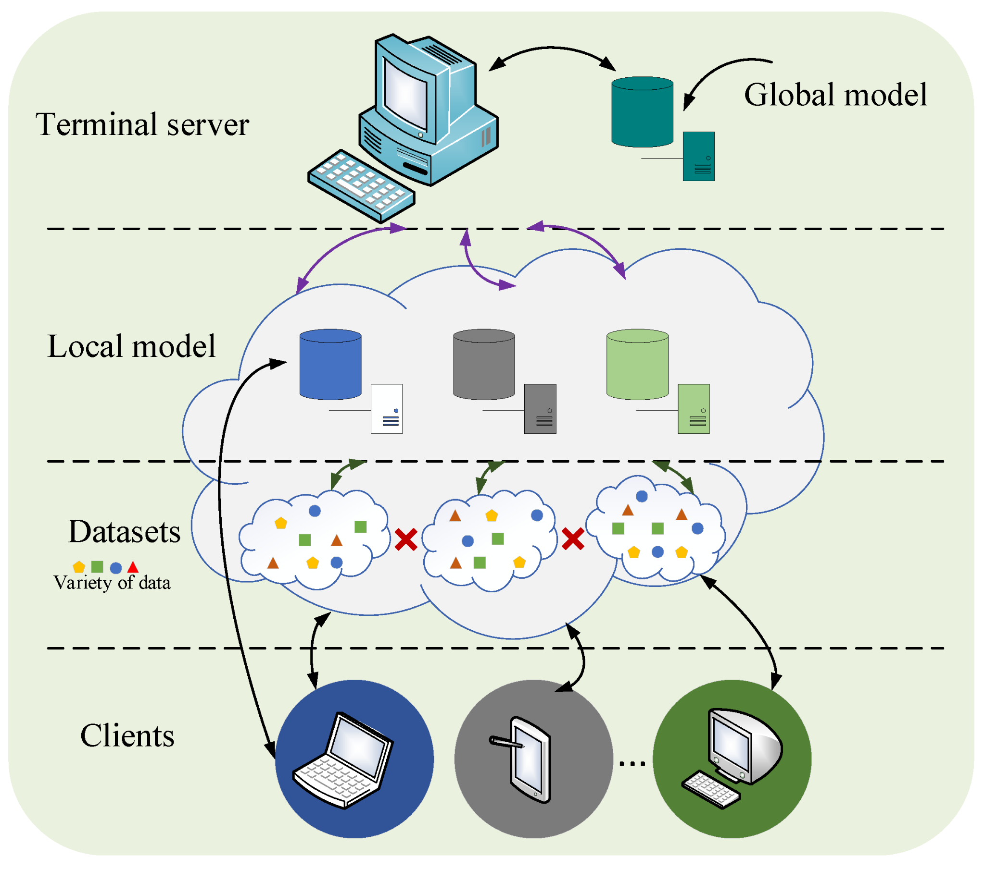
Training Without Centralizing Data
Local Data Retention Voice data (accents, vocabulary, patterns)
On-Device Training Learns traits like pronunciation, tone, and preferences.
Encrypted Model Updates Anonymized, encrypted model updates..
Central Aggregation Securely combined to create a smarter global model.
Global Model Sync Devices receive the improved model, boosting accuracy.

Slide 21
Project: Privacy-Preserving AI for Smart Healthcare
Feature selection and data generalization
Gradient clipping and differential privacy
Feature-based data partitioning
Five hospitals with non-IID data
Models: Logistic Regression, Random Forest
Tools: Flower, Scikit-learn, NumPy, Pandas, Matplotlib

Slide 22
Technical Challenges
Privacy Leakage via Gradients – Differential Privacy + gradient clipping + secure aggregation
Heterogeneous Data & Devices – Tune hyperparameters per client + Diverse Client Sampling
Communication Overhead - Compress model updates + Sparse Communication + Optimized Communication Rounds

Slide 23
Future Trends
Enhanced Privacy: Differential Privacy + Secure Aggregation
Federated Analytics: Insights Without Exposure
Federated Transfer Learning: Personalized, Yet Private
Not just about decentralization,
it’s about ethical AI, secure collaboration, and global intelligence without data compromise.

Slide 24
References
Flower: A Friendly Federated Learning Research Framework
TensorFlow Federated: Machine Learning on Decentralized Data with Privacy
Benchmarking PySyft Federated Learning Framework on MIMIC-III Dataset
Federated Learning Flower
Gamma AI

Slide 25


